Slide 1
New Process to Model Thermo-physical Fluid Properties
Michael Hiegemann
ETHZ/UZH Computational Science Industry Week
27/10/2014

Slide 2
Agenda
Problem area: Power plant performance simulation
Problem statement
Questions, Ideas and Proposals
Data, Literature and Tools

Slide 3
Agenda
Problem area: Power plant performance simulation
Problem statement
Questions, Ideas and Proposals
Data, Literature and Tools

Slide 4
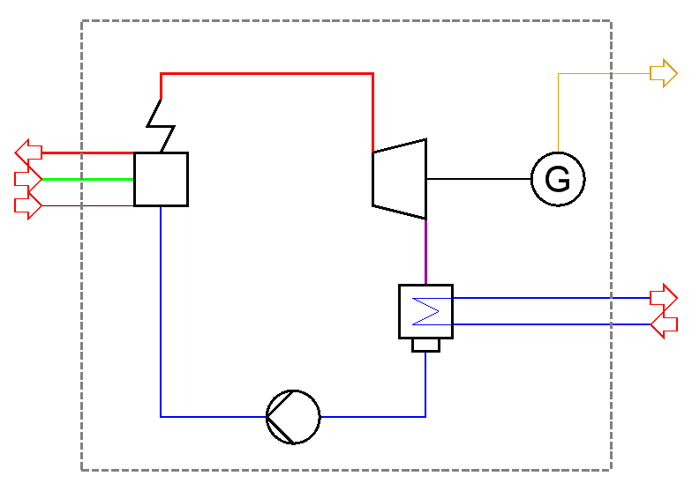
Power Plant Performance Simulation – Basic Aspects
Thermodynamic modeling needs to take into account
System boundary
Components
Interfaces between components, i.e.
flow quantities
pressure
temperature
thermo-physical properties of the working fluid (e.g. specific heat capacity, specific enthalpy, etc.)
Electricity
Flue gas
Air
Fuel
Coolant out
Coolant in
Fluid properties are an essential part of performance modeling

Slide 5
Power Plant Performance Simulation – Basic Aspects
Simulations are required for
Component and plant design
Tendering including guarantee
Order execution
Plant operation
Technical and commercial requirements asked for increasing accuracy of the performance prediction
Accuracy to the per mille level is required for reasons of competitiveness
Simulation tool components
Mathematical solver
Component models (calibrated from plant experience feedback)
Fluid models (correlated from empirical data)
Example: adiabatic turbine
Precise performance prediction requires precise fluid models

Slide 6
Thermo-physical Fluid Properties – Working Media
“Well understood” media
Air
Water/Steam
Flue gas
Fuel gas, fuel oil, coals
Solids (fly ash, slag, gypsum, limestone)
Lube oil
Hydrogen
Properties required for simulation
Volumetric properties:
Caloric properties:
Transport properties:
Combined:
“Challenging” media
Sea water
Geothermal fluids
ORC fluids
Molten salts
Heat transfer fluids
CO2 rich solutions
Many fluids and fluid properties are required by simulation …

Slide 7
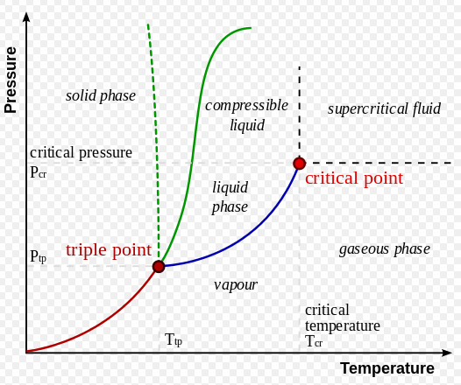
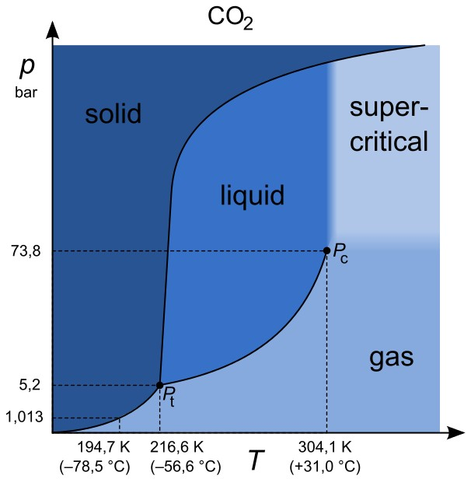
Thermo-physical Fluid Properties – Media and Phases
Media
Pure fluids
Mixtures
Fluid state: Comprises the liquid, the gaseous, the supercritical and most two-phase states
Mixture: Consists out of more than one chemical
Single Phase
Solid
Liquid
Gaseous
Supercritical
Multi-Phase
Two phases
Three or more phases
… and multiple phases and mixtures make it even more complex

Slide 8
Thermo-physical Fluid Properties – Measurements
Volumetric data
Single phase: – Density measurements (magnetic suspension balance) at given pressure and temperature
Two-phase: – Saturation data (VLE) measurements (saturation pressure and two densities at given temperature)
Caloric data, usually for single-phase
: Calorimeters
: Calorimeters
: Travelling time measurements
Heat of evaporation
High precision measurement are somewhat like an art

Slide 9
Thermo-physical Fluid Properties – Correlation
Fundamental equations and
are obtained consistently as derivatives
– the Gibbs free energy enables the description of the single phase properties, e.g. for solids
– the Helmholtz free energy enables the description of the single and the two phase properties using Maxwell relations
The physical framework of the problem is given
The mathematical approximation of is open
Fundamental equations are state of the art for real fluids

Slide 10
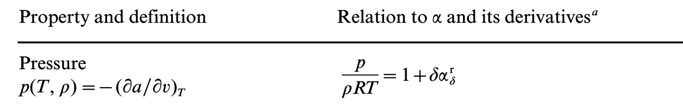
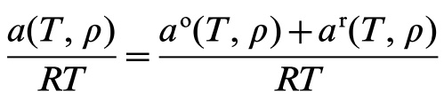

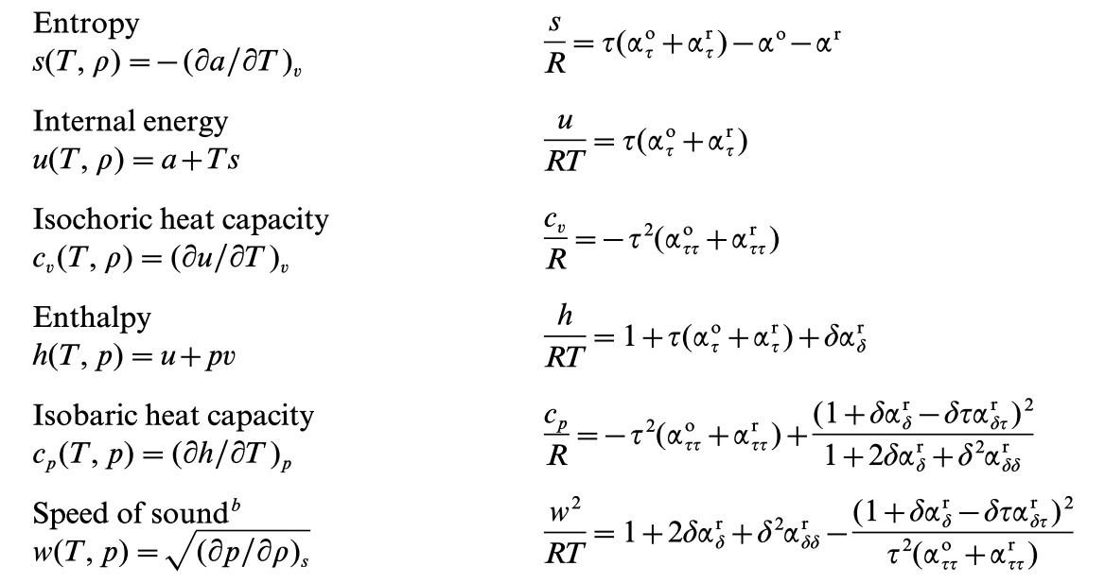
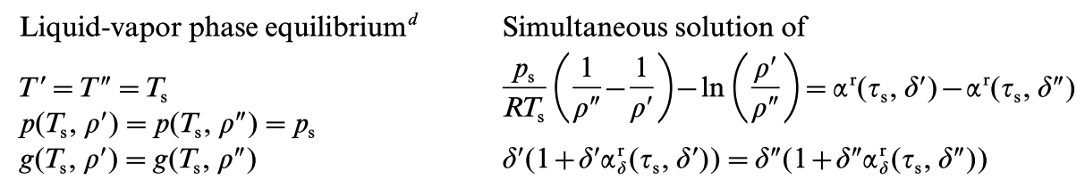
Thermo-physical Fluid Properties – Helmholtz Free Energy

Slide 11
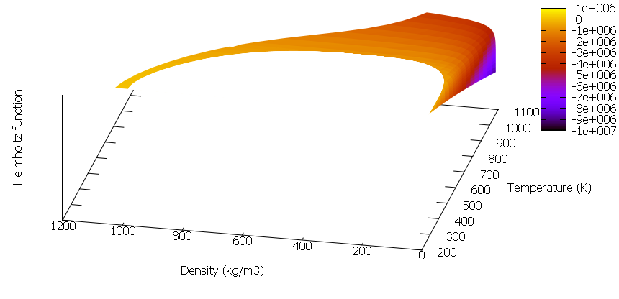
Thermo-physical Fluid Properties – Helmholtz Free Energy
[J/kg]
[K]
[kg/m3]
611.657 Pa <= <= 100 MPa, 273.16 K <= <= 1073.15 K
Domain of definition with a “hole”, steep gradients at low densities

Slide 12
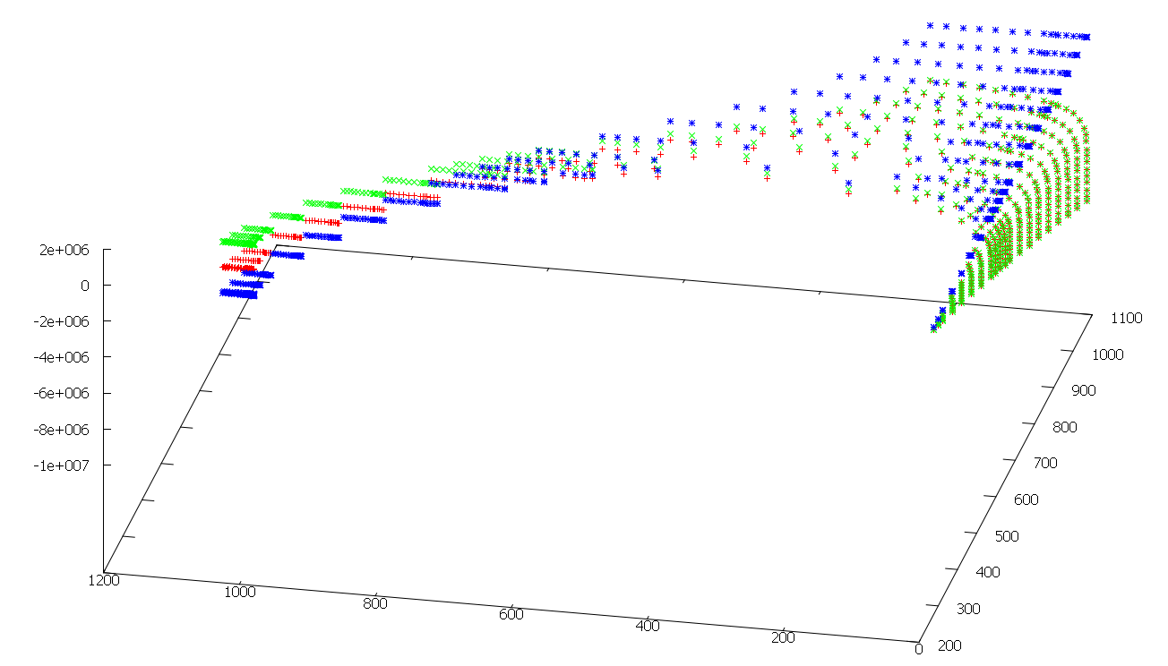
Thermo-physical Fluid Properties – Helmholtz Free Energy
[J/kg]
[K]
[kg/m3]
Helmholtz function: red, ideal part: green, residual part: blue

Slide 13
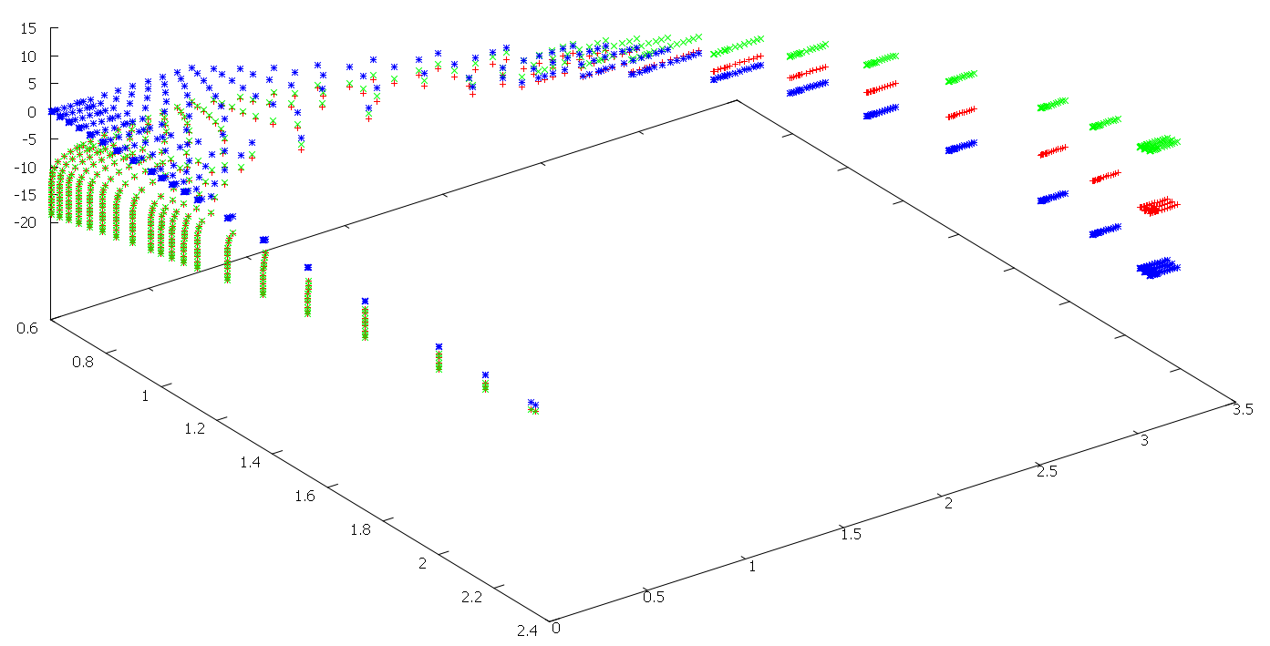
Thermo-physical Fluid Properties – Helmholtz Free Energy
Reduced Helmholtz function: red, ideal part: green, residual part: blue

Slide 14
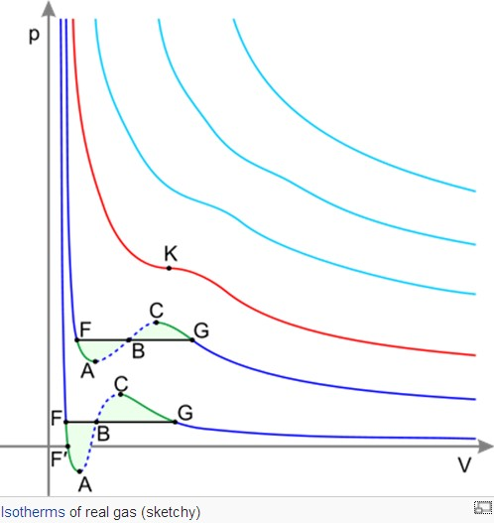
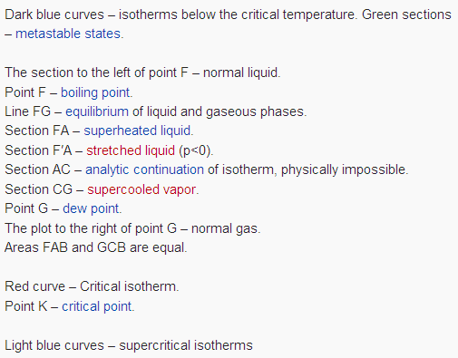
Thermo-physical Fluid Properties – Maxwell Criteria
Points F to K and G to K form the saturation lines

Slide 15
Agenda
Problem area: Power plant performance simulation
Problem statement
Questions, Ideas and Proposals
Data, Literature and Tools

Slide 16
Problem statement – Problem Features
cannot be measured directly, but derivatives can
The function has a kind of hole (the two-phase area), and the position of it needs to be determined
There are requirements on the monotonic and asymptotic behaviours of the function and its derivatives
Constraints may need to be obeyed (e.g. the position of the triple point or of the critical point)
Temperature [K] and density cannot go below zero
varies by several orders of magnitude
Practical application aspects require to find a balance between correlation accuracy and computation speed
Fitting the Helmholtz function is an unusual approximation task

Slide 17
Problem statement – Current Process
Define “bank of terms”, i.e. a set of heuristically selected functions
Execute parameter fittings for a large number of different combinations of functions from the above set
Select “best” combination
Determine errors
Current process is based on heuristic approach

Slide 18
Problem statement – Industrial Formulations using Sub-regions
100 MPa/1000 bar
g(p,T)
f(v,T)
g(p,T)
1
3
2
50 MPa/500 bar
g(p,T)
16.5 MPa/165 bar
5
4
611Pa/0.0006 bar
273.16 K
0.01°C
623.15 K
350°C
863.15 K
590°C
1073.15 K
800°C
2273.15 K
2000°C
Workaround for faster evaluation

Slide 19
Problem statement – Artifacts of the Industrial Formulations
250 bar
IFC67 and IAPWS-IF97 suffer from artifacts at the sub-region boundaries

Slide 20
Problem statement – Issues of Current Process
No exploitation of the properties of orthogonal function systems
Wavy behaviour in some places
Missing monotonic and asymptotic features in some areas
Lots of further artefacts, i.e. spikes in the two-phase area
Higher number of functions does not necessarily increase the quality of the approximation
SLOW evaluation
Complex structure of the function and its derivatives
Process is not generic, i.e. there is a different functional form for the reference equation of each fluid
Missing link to the area of mathematical approximation theory

Slide 21
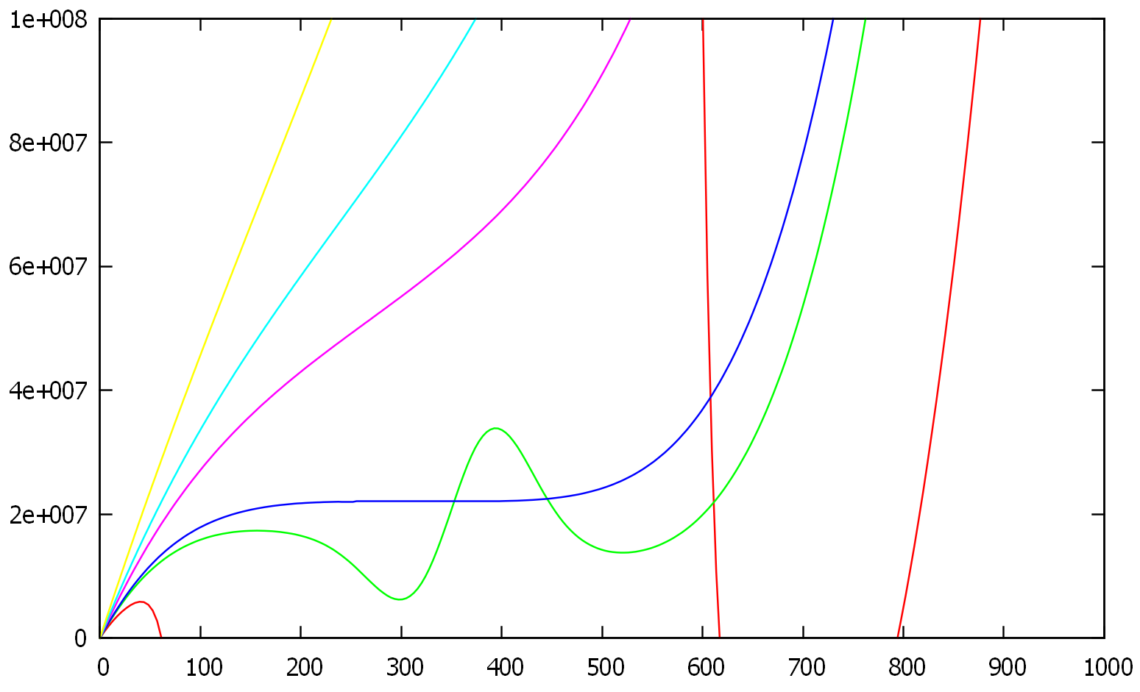
Problem Statement – Behaviour in the Two-phase Region
1073.15 K
873.15 K
773.15 K
IAPWS-95
[Pa]
623.15 K
647.1 K
523.15 K
[kg/m3]
Spikes in the two-phase area jeopardize flash calculations

Slide 22
Agenda
Problem area: Power plant performance simulation
Problem statement
Questions, Ideas and Proposals
Data, Literature and Tools

Slide 23
Questions
How to identify an ansatz for ?
Use analytic terms / non-analytic terms?
How to identify
the quality of a measurement series?
outliers?
How to define weights of a data point / data series?
How to make an accuracy / error statement?
What is a reasonable approximation criterion?
Use sequential or simultaneous approximation process?
How many data points are required for a good fit?
Multiple inter-linked problem areas

Slide 24
Ideas and Proposals
Use orthogonal polynomials
“Unless you’re sure another set of basis functions is better, use Chebyshev polynomials.
Unless you’re really, really sure that another set of basis functions is better, use Chebyshev polynomials.” J.P. Boyd, Chebyshev and Fourier spectral methods, p. 10: “Moral Principle 1”
Use coordinate transformations – to be identified
Define a sole form for approximations of , generically applicable to all fluids
one code for evaluation, but different sets of series coefficients and parameters for coordinate transformations
Identify and exploit asymptotic behaviour
Identify consistency checks / plots
Allow for constraints
Introduce and exploit interdisciplinary methodology

Slide 25
Agenda
Problem area: Power plant performance simulation
Problem statement
Questions, Ideas and Proposals
Data, Literature and Tools

Slide 26
Data, Literature and Tools
Span, R.: Multiparameter Equations of State, Springer 2000.
www.iapws.org (24000 data, IAPWS-95 formulation)
Wagner, W., Pruss, A.: The IAPWS formulation 1995 for the thermodynamic properties of ordinary water substance for general and scientific use, J. Phys. Chem. Ref. Data 31, No. 2, 387-535 (2002).
http://www.peter-junglas.de/fh/water95/index.html (IAPWS-95 in Matlab)
http://www.peter-junglas.de/fh/publications/Poster-11_junglas.pdf (discussion on artefacts of IAPWS-95)
Abdulagatov, (new data on properties of supercooled water, no further details yet)
Bain, R.W.: Steam Tables 1964, Physical properties of water and steam, 0-800°C, 0-1000 bars, H.M.S.O., Edinburgh,1964, and Bain, R.W.: The preparation of steam tables with the aid of a digital computer, J. mech. Engng. Sci. 3, No. 4, 289-294 (1961) (first use of Chebyshev series in this field)
http://en.wikipedia.org/wiki/Book:Thermodynamics
Hayes, J.G. (ed.): Numerical approximation to functions and data, The Athlone Press 1970 (discussion of 1D and 2D data fittings and the treatment of constraints to be imposed on an approximation).
Trefethen, L.N.: Approximation theory and approximation practice, SIAM 2012
http://www.chebfun.org and the references therein
http://www-personal.umich.edu/~jpboyd/aaabook_9500may00.pdf (Chebyshev and Fourier spectral methods, for coordinate transformations see chapters 16 and 17)

Slide 27

This Week
Now the ball is in your court …
… we will be available for any support!

